Slide 1
SWAGGER CODE GENERATION FOR REACT
TECH AT AGODA #8
29 APRIL 2017
BY PANU AUSAVASEREELERT

Slide 2
ABOUT ME
PANU AUSAVASEREELERT
SENIOR SOFTWARE ENGINEER AT AGODA
2 YEARS AT AGODA
HOTEL TEAM AND NHA TEAM
Notes:
I HAVE BEEN WORKING AT AGODA FOR 2 YEARS

Slide 3
TECHNOLOGY THAT WE USE
SWAGGER
SWASH BUCKLE
AUTOREST
TYPESCRIPT
REACT

Slide 4

WHAT IS SWAGGER?
Notes:
Swagger is open source tool that help you DESIGN, BUILD, DOCUMENT, and CONSUME your RESTfulAPIs.
Swagger is a JSON format which describes HTTP based APIs to enable automatic documentation among other things.

Slide 5
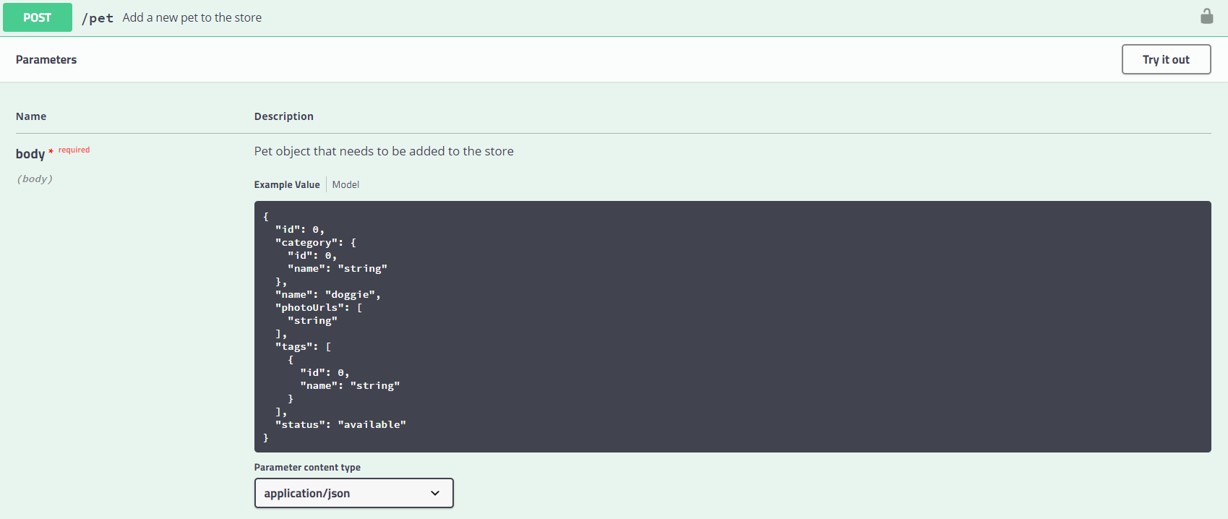
SWAGGER – GENERATE RESTFUL API DOCUMENT

Slide 6
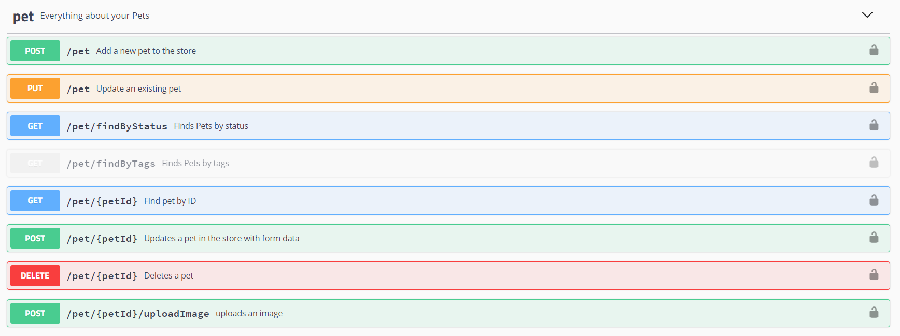
SWAGGER PETSTORE

Slide 7

ARCHITECTURE
WEB API
SWASHBUCKLE

Slide 8
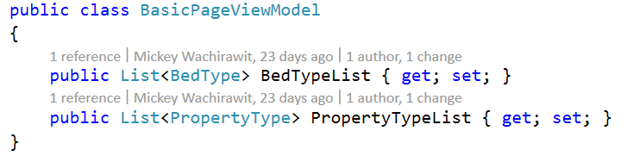
SWASHBUCKLE – MODEL
Notes:
A great nuget package to auto generate your Swagger JSON file is Swashbuckle.
Swashbuckle Seamlessly adds a Swagger to WebApi projects! It combines ApiExplorer and Swagger/swagger-ui to provide a rich discovery, documentation and playground experience to your API consumers.

Slide 9
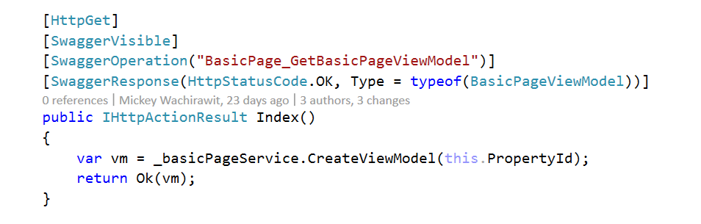
SWASHBUCKLE – API CLIENT
Notes:
A great nuget package to auto generate your Swagger JSON file is Swashbuckle.
Swashbuckle Seamlessly adds a Swagger to WebApi projects! It combines ApiExplorer and Swagger/swagger-ui to provide a rich discovery, documentation and playground experience to your API consumers.

Slide 10


ARCHITECTURE
WEB API
SWASHBUCKLE
MODELS
CLIENT
ENDPOINTS

Slide 11
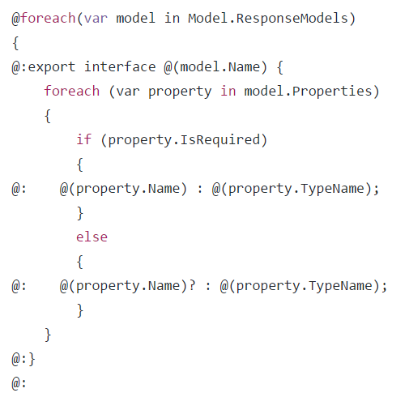
AUTOREST – Model template
ModelTemplate.cshtml
Notes:
The AutoRest tool generates client libraries for accessing RESTful web services.
Go, Java, NodeJs, Python, Ruby, C#

Slide 12
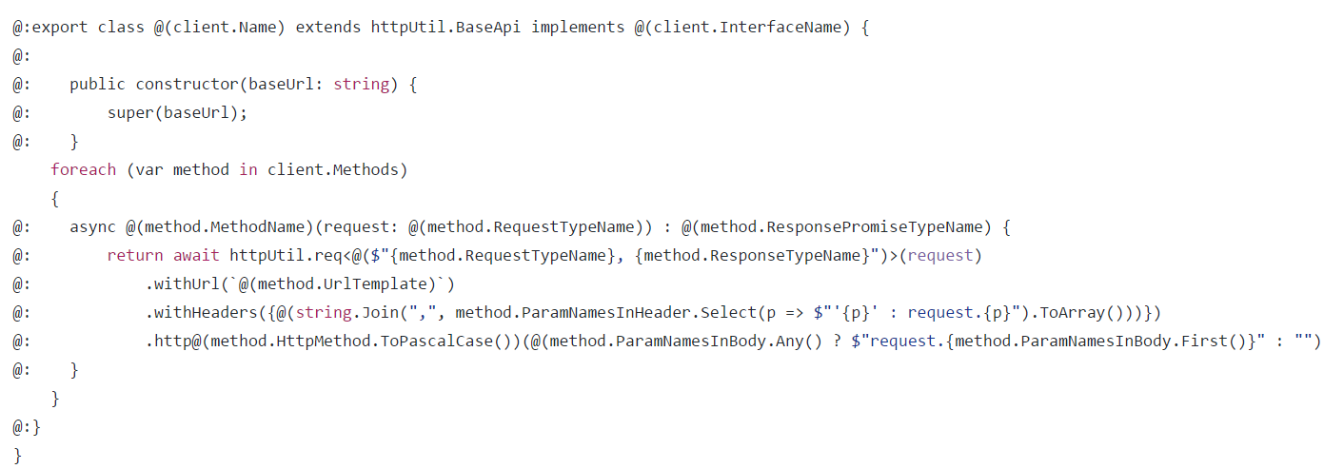
AUTOREST – Client endpoint template
ClientTemplate.cshtml
Notes:
We create ClientAPI template and Model template to generate Typescript

Slide 13

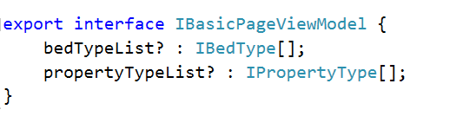
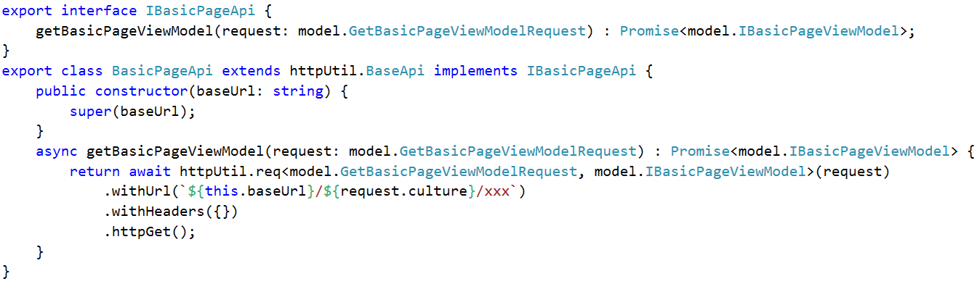
AUTOREST – tool for generates client lib for RESTful web service
MODEL
CLIENT ENDPOINT
Notes:
We create ClientAPI template and Model template to generate Typescript

Slide 14

ARCHITECTURE
WEB API
SWASHBUCKLE
MODELS
CLIENT
ENDPOINTS

Slide 15
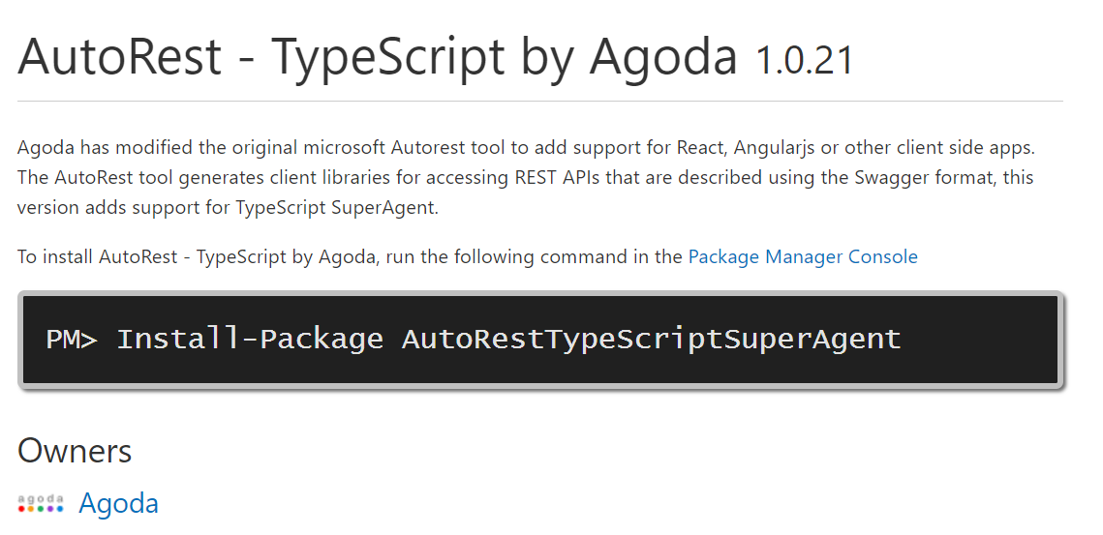
AUTOREST – TypeScript by Agoda
https://www.nuget.org/packages/AutoRestTypeScriptSuperAgent/1.0.21
Notes:
Agoda has modified the original microsoft Autorest tool to add support for React, Angularjs or other client side apps. The AutoRest tool generates client libraries for accessing REST APIs that are described using the Swagger format, this version adds support for TypeScript SuperAgent.

Slide 16
Q&A
TECH AT AGODA #8
29 APRIL 2017
BY PANU AUSAVASEREELERT

